Slide 1


Topic 10: Oligopoly Matěj Bajgar matej.bajgar@fsv.cuni.cz
Microeconomics II
What do they have in common?

Slide 2

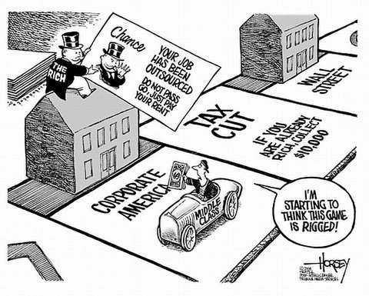

Introduction
Notes:
Cars
Airlines
Banks
Operating systems
Mobile phones
Village pubs

Slide 3
Introduction
Oligopoly = a market with several competitors
N^{MONOPOLY} < N^{OLIGOPOLY} < N^{PERFECT COMPETITION}
Firms affect price
Strategic interaction between firms
Duopoly = oligopoly with 2 firms
Examples of oligopolistic markets?
Notes:
Cars
Airlines
Banks
Operating systems
Mobile phones
Village pubs

Slide 4
Introduction
Oligopoly = a market with several competitors
N^{MONOPOLY} < N^{OLIGOPOLY} < N^{PERFECT COMPETITION}
Firms affect price
Strategic interaction between firms
Duopoly = oligopoly with 2 firms
Many types of settings
Simultaneous vs. sequential decisions
Price vs. quantity setting
Homogenous vs. diversified product
Competitive vs. cooperative

Slide 5
Roadmap
Homogenous products
Sequential quantity setting (the Stackelberg model)
Simultaneous quantity setting (the Cournot model)
Simultaneous price setting (the Bertrand model)
Cooperative game (Collusion)
Differentiated products
Simultaneous price setting (the Bertrand model)
the Hotteling model
Monopolistic competition

Slide 6


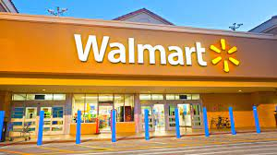

Motivation
Most markets can be described as oligopolies
Foundation for algorithmic pricing, high-frequency pricing...
The bread and butter of anti-trust

Slide 7

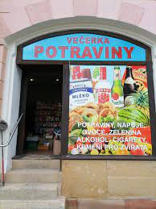
Sequential quantity setting (Stackelberg)
Two firms
Quantity leader (firm 1): a dominant firm who sets the quantity.
Quantity follower (firm 2): takes the quantity of the leader as given.
Examples of quantity leaders
A B C

Slide 8

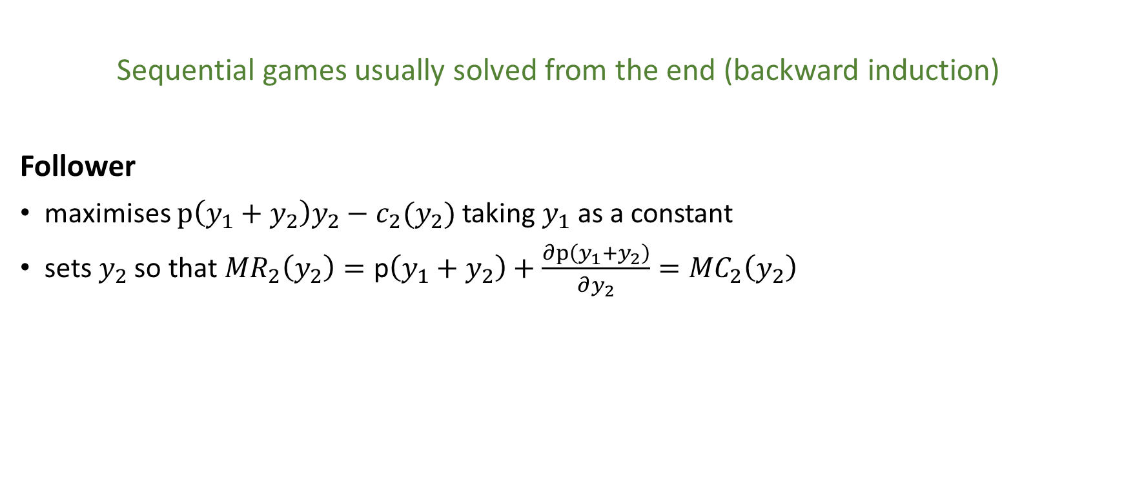
Sequential quantity setting (Stackelberg)
Sequential games usually solved from the end (backward induction)
Follower
maximises $p\left(y_{1}+y_{2}\right)y_{2}−c_{2}(y_{2})$ taking $y_{1}$ as a constant
sets $y_{2}$so that ${MR}_{2}\left(y_{2}\right)=\text{p}\left(y_{1}+y_{2}\right)+\frac{∂p\left(y_{1}+y_{2}\right)}{∂y_{2}}={MC}_{2}\left(y_{2}\right)$

Slide 9
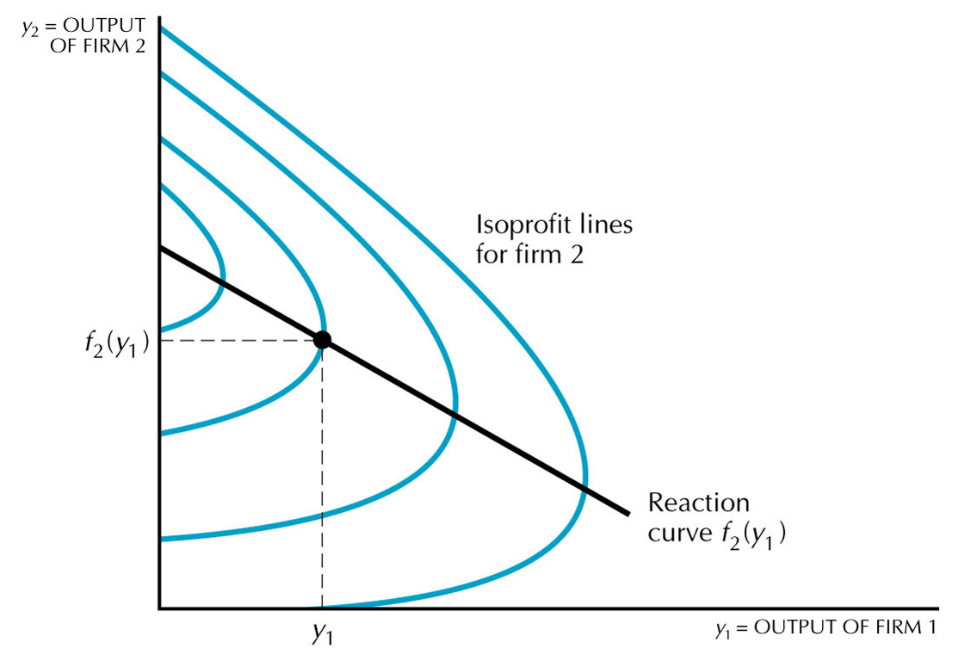
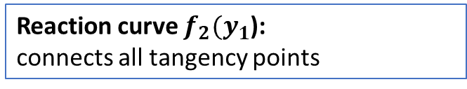
Sequential quantity setting (Stackelberg)
Tangency points: points where vertical lines touch isoprofit curves
Reaction curve $f_{2}(y_{1}$):
connects all tangency points

Slide 10
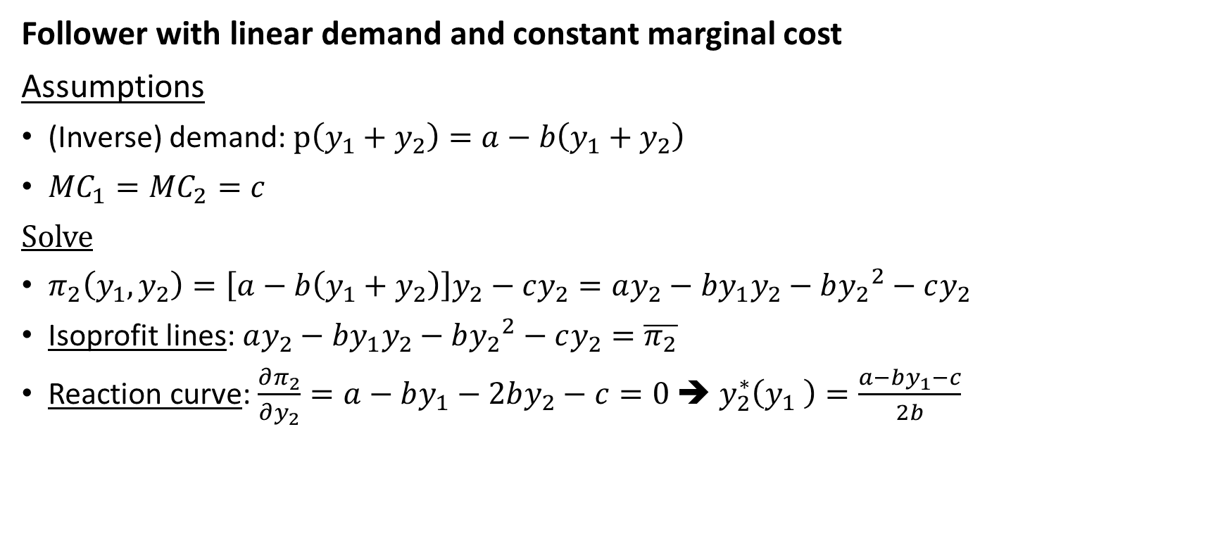
Sequential quantity setting (Stackelberg)
Follower with linear demand and constant marginal cost
Assumptions
(Inverse) demand: $p\left(y_{1}+y_{2}\right)=a−b\left(y_{1}+y_{2}\right)$
${MC}_{1}={MC}_{2}=c$
Solve
$π_{2}\left(y_{1},y_{2}\right)=\left[a−b\left(y_{1}+y_{2}\right)\right]y_{2}−cy_{2}=ay_{2}−by_{1}y_{2}−b{y_{2}}^{2}−cy_{2}$
Isoprofit lines: $ay_{2}−by_{1}y_{2}−b{y_{2}}^{2}−cy_{2}=\overline{π_{2}}$
Reaction curve: $\frac{∂π_{2}}{∂y_{2}}=a−by_{1}−2by_{2}−c=0$ ➔ $y_{2}^{∗}\left(y_{1} \right)=\frac{a−by_{1}−c}{2b}$

Slide 11
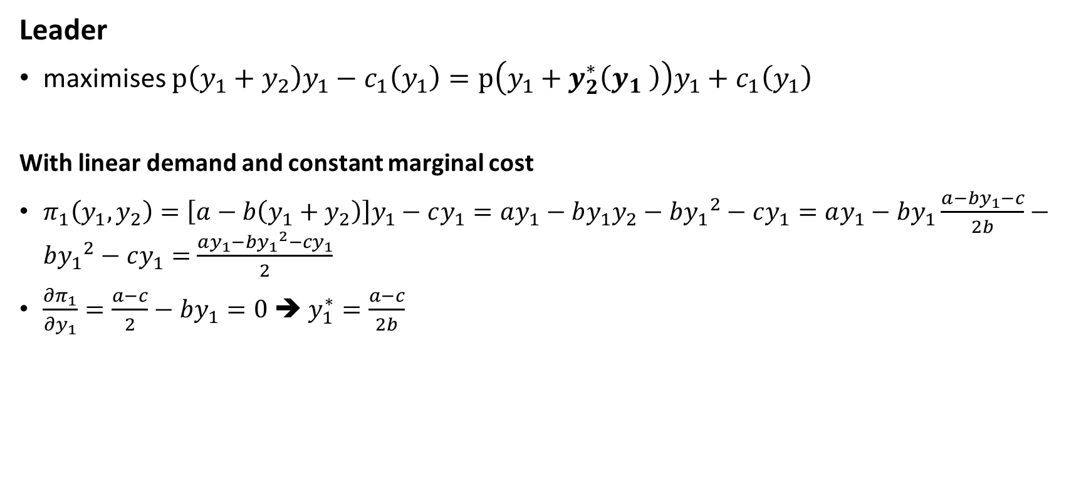
Sequential quantity setting (Stackelberg)
Leader
maximises $p\left(y_{1}+y_{2}\right)y_{1}−c_{1}\left(y_{1}\right)=p\left(y_{1}+y_{2}^{∗}\left(y_{1} \right)\right)y_{1}+c_{1}\left(y_{1}\right)$
With linear demand and constant marginal cost
$π_{1}\left(y_{1},y_{2}\right)=\left[a−b\left(y_{1}+y_{2}\right)\right]y_{1}−cy_{1}=ay_{1}−by_{1}y_{2}−b{y_{1}}^{2}−cy_{1}=ay_{1}−by_{1}\frac{a−by_{1}−c}{2b}−b{y_{1}}^{2}−cy_{1}=$ $\frac{ay_{1}−b{y_{1}}^{2}−cy_{1}}{2}$
$\frac{∂π_{1}}{∂y_{1}}=\frac{a−c}{2}−by_{1}=0$ ➔ $y_{1}^{∗}=\frac{a−c}{2b}$

Slide 12
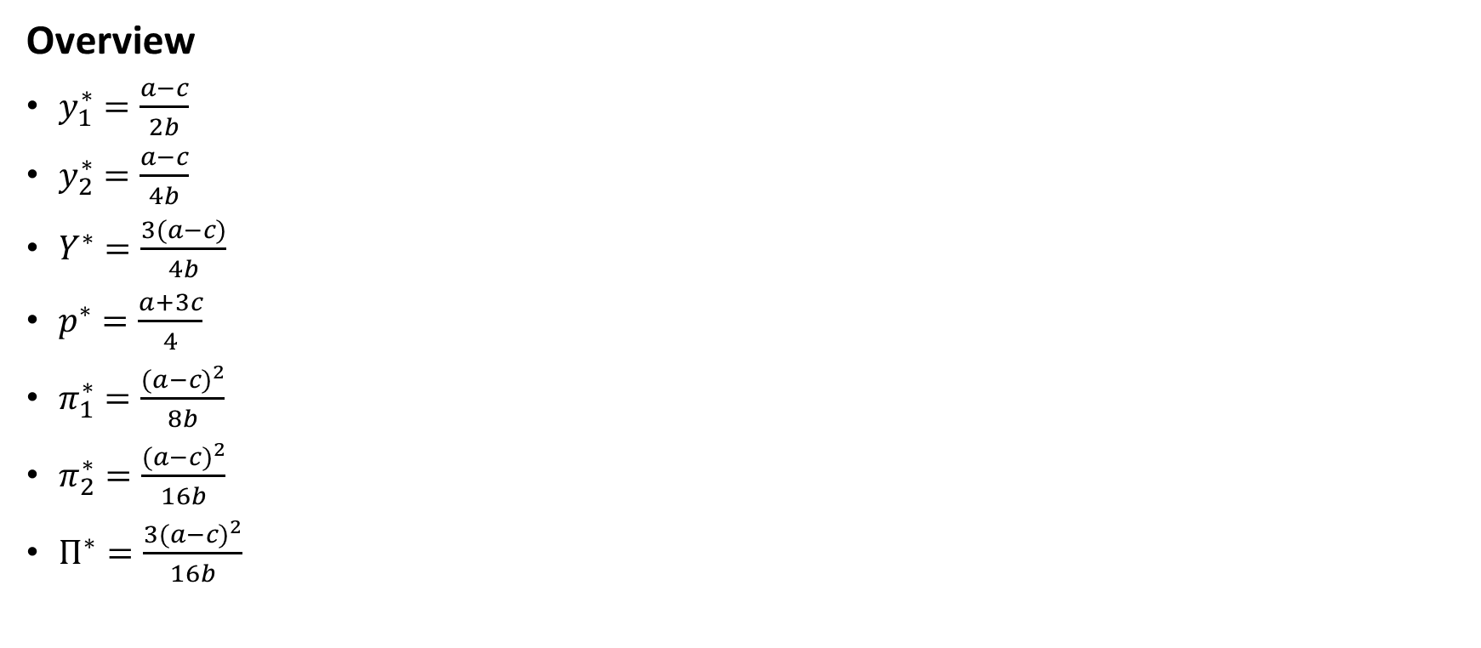
Sequential quantity setting (Stackelberg)
Overview
$y_{1}^{∗}=\frac{a−c}{2b}$
$y_{2}^{∗}=\frac{a−c}{4b}$
$Y^{∗}=\frac{3(a−c)}{4b}$
$p^{∗}=\frac{a+3c}{4}$
$π_{1}^{∗}=\frac{{(a−c)}^{2}}{8b}$
$π_{2}^{∗}=\frac{{(a−c)}^{2}}{16b}$
$Π^{∗}=\frac{3{(a−c)}^{2}}{16b}$

Slide 13
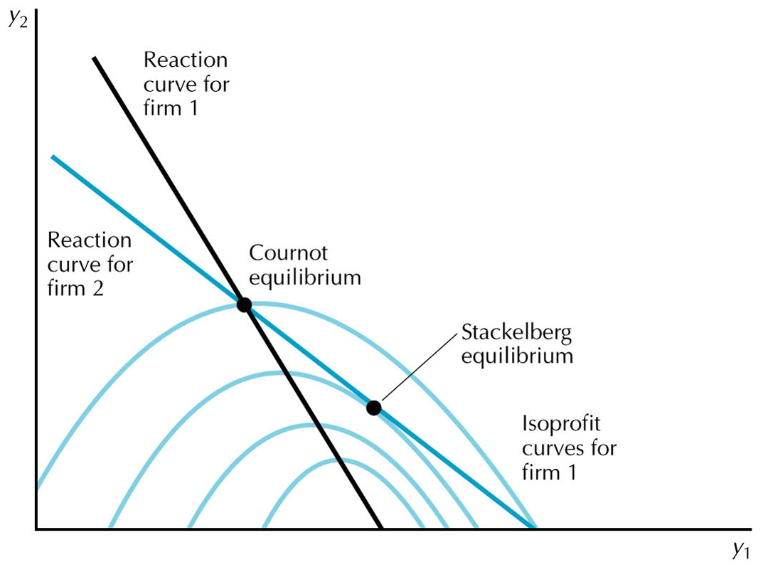
Sequential quantity setting (Stackelberg)

Slide 14

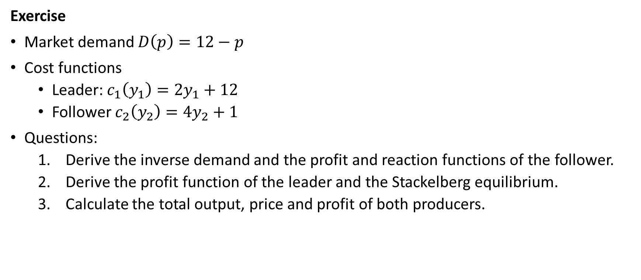
Sequential quantity setting (Stackelberg)
Exercise
Market demand $D\left(p\right)=12−p$
Cost functions
Leader: $c_{1}\left(y_{1}\right)=2y_{1}+12$
Follower $c_{2}\left(y_{2}\right)=4y_{2}+1$
Questions:
Derive the inverse demand and the profit and reaction functions of the follower.
Derive the profit function of the leader and the Stackelberg equilibrium.
Calculate the total output, price and profit of both producers.

Slide 15
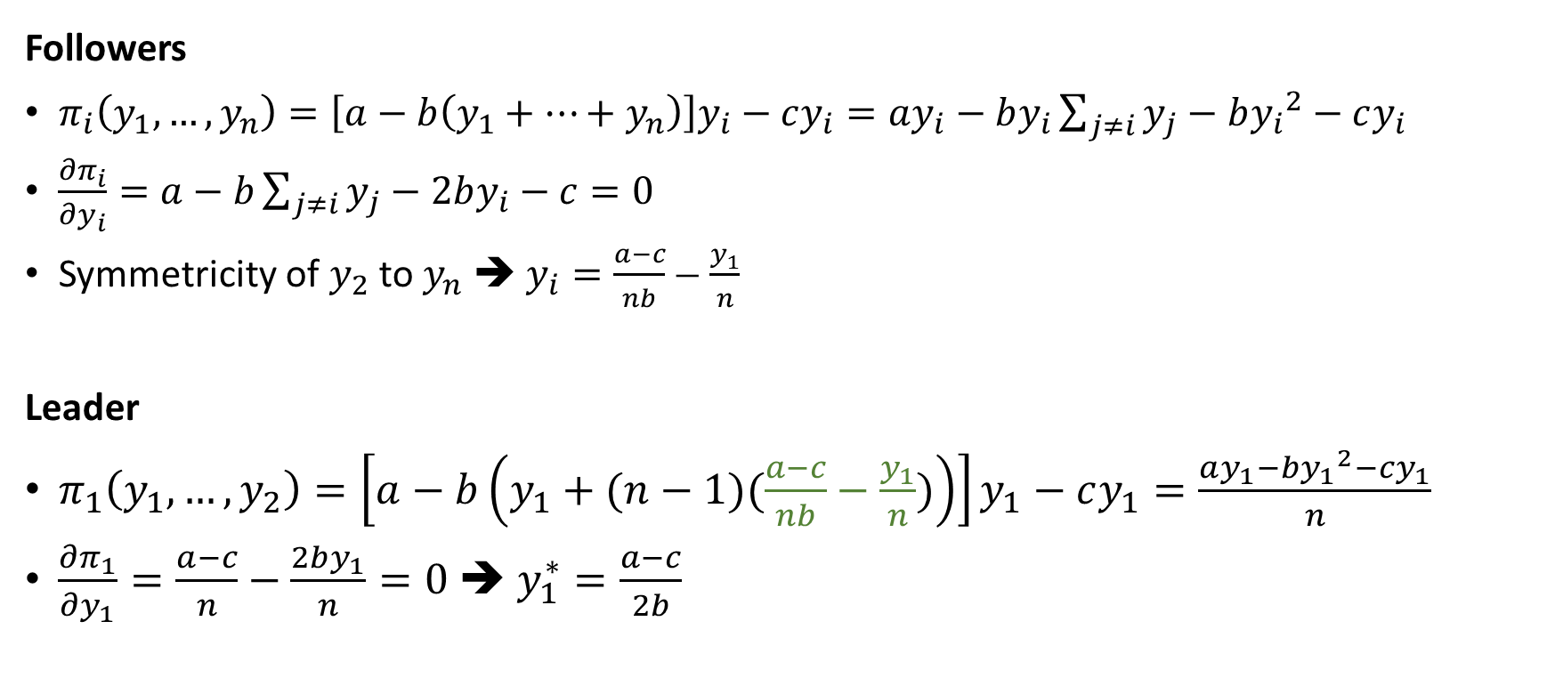
Sequential quantity setting with more followers
Followers
$π_{i}\left(y_{1},…,y_{n}\right)=\left[a−b\left(y_{1}+…+y_{n}\right)\right]y_{i}−cy_{i}=ay_{i}−by_{i}\sum_{j≠i}{y_{j}}−b{y_{i}}^{2}−cy_{i}$
$\frac{∂π_{i}}{∂y_{i}}=a−b\sum_{j≠i}{y_{j}}−2by_{i}−c=0$
Symmetricity of $y_{2}$ to $y_{n}$ ➔ $y_{i}=\frac{a−c}{nb}−\frac{y_{1}}{n}$
Leader
$π_{1}\left(y_{1},…,y_{2}\right)=\left[a−b\left(y_{1}+(n−1)(\frac{a−c}{nb}−\frac{y_{1}}{n})\right)\right]y_{1}−cy_{1}=\frac{ay_{1}−b{y_{1}}^{2}−cy_{1}}{n}$
$\frac{∂π_{1}}{∂y_{1}}=\frac{a−c}{n}−\frac{2by_{1}}{n}=0$ ➔ $y_{1}^{∗}=\frac{a−c}{2b}$

Slide 16
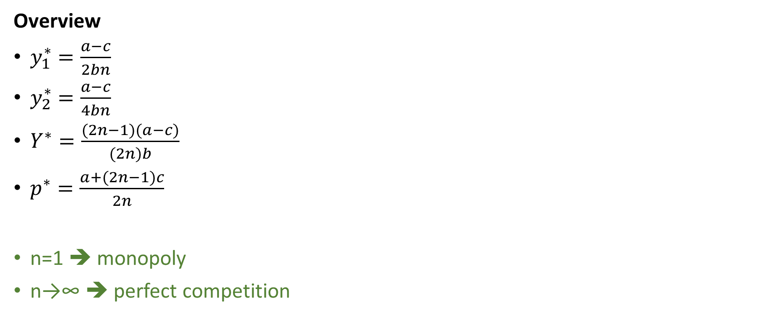
Sequential quantity setting with more followers
Overview
$y_{1}^{∗}=\frac{a−c}{2bn}$
$y_{2}^{∗}=\frac{a−c}{4bn}$
$Y^{∗}=\frac{(2n−1)(a−c)}{(2n)b}$
$p^{∗}=\frac{a+(2n−1)c}{2n}$
n=1 ➔ monopoly
n→∞ ➔ perfect competition

Slide 17
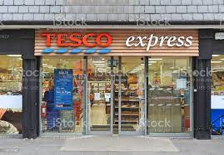


Simultaneous quantity setting (Cournot)
2 (or more) firms deciding quantity simultaneously
Examples
A B C

Slide 18
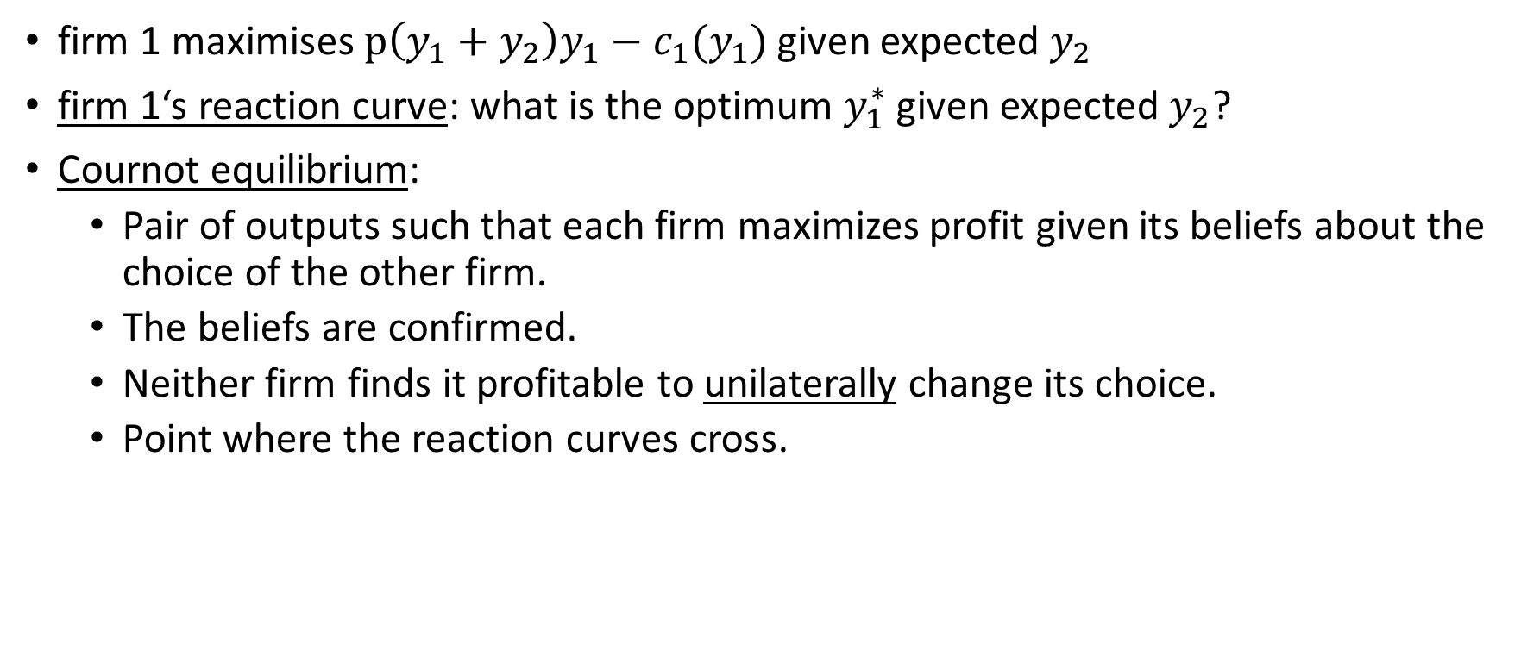
Simultaneous quantity setting (Cournot)
firm 1 maximises $p\left(y_{1}+y_{2}\right)y_{1}−c_{1}(y_{1})$ given expected $y_{2}$
firm 1‘s reaction curve: what is the optimum $y_{1}^{∗}$ given expected $y_{2}$?
Cournot equilibrium:
Pair of outputs such that each firm maximizes profit given its beliefs about the choice of the other firm.
The beliefs are confirmed.
Neither firm finds it profitable to unilaterally change its choice.
Point where the reaction curves cross.

Slide 19
Simultaneous quantity setting (Cournot)

Slide 20
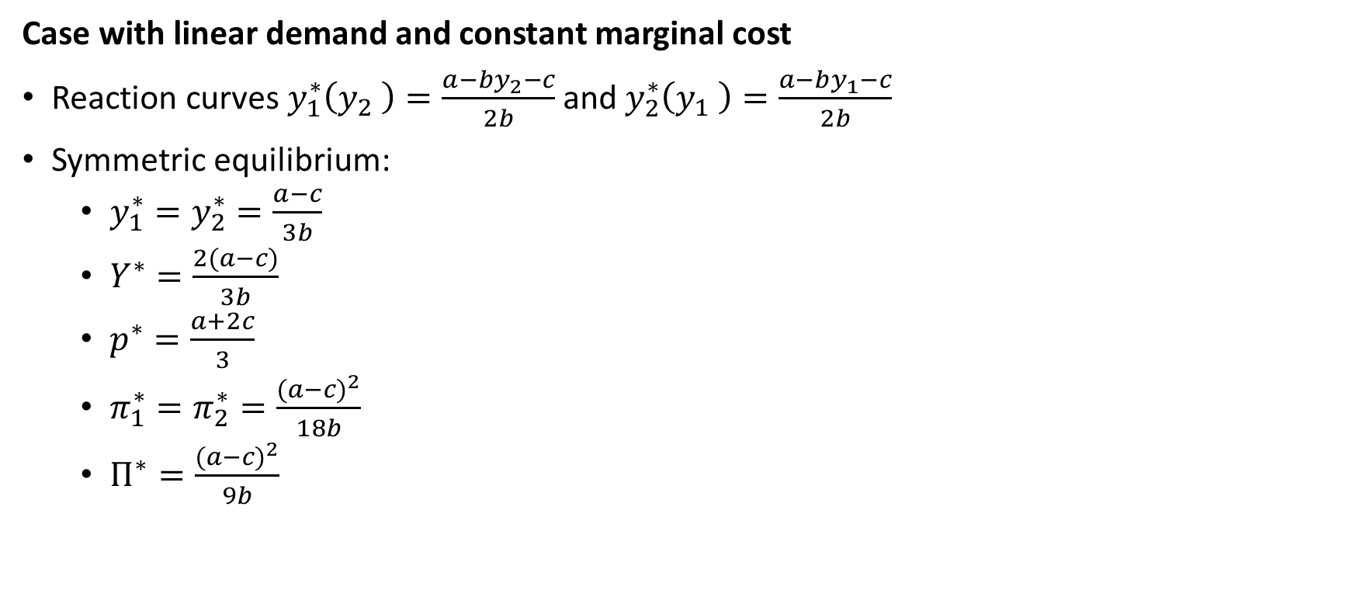
Simultaneous quantity setting (Cournot)
Case with linear demand and constant marginal cost
Reaction curves $y_{1}^{∗}\left(y_{2} \right)=\frac{a−by_{2}−c}{2b}$ and $y_{2}^{∗}\left(y_{1} \right)=\frac{a−by_{1}−c}{2b}$
Symmetric equilibrium:
$y_{1}^{∗}=y_{2}^{∗}=\frac{a−c}{3b}$
$Y^{∗}=\frac{2(a−c)}{3b}$
$p^{∗}=\frac{a+2c}{3}$
$π_{1}^{∗}=π_{2}^{∗}=\frac{{(a−c)}^{2}}{18b}$
$Π^{∗}=\frac{{(a−c)}^{2}}{9b}$

Slide 21
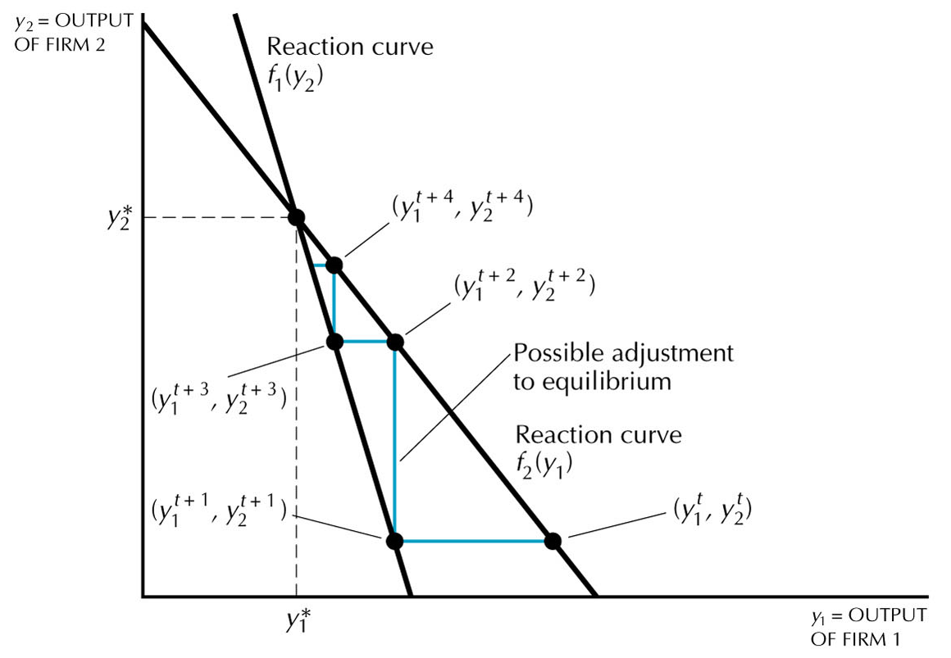
Simultaneous quantity setting (Cournot)
Notes:
Firm 1 thinks: given y2, am producing too much and reduces
Firm 2 thinks: given y1, am producing too little and increases
etc.

Slide 22
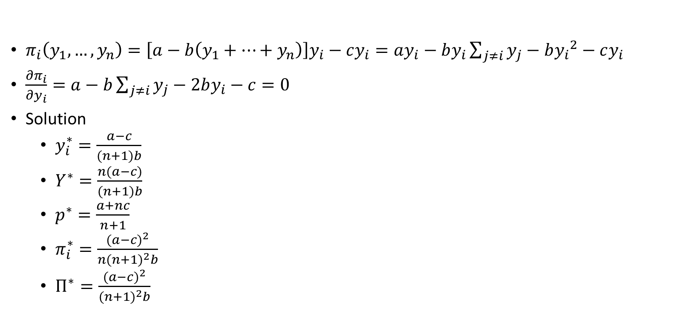
Simultaneous quantity setting with more firms
$π_{i}\left(y_{1},…,y_{n}\right)=\left[a−b\left(y_{1}+…+y_{n}\right)\right]y_{i}−cy_{i}=ay_{i}−by_{i}\sum_{j≠i}{y_{j}}−b{y_{i}}^{2}−cy_{i}$
$\frac{∂π_{i}}{∂y_{i}}=a−b\sum_{j≠i}{y_{j}}−2by_{i}−c=0$
Solution
$y_{i}^{∗}=\frac{a−c}{(n+1)b}$
$Y^{∗}=\frac{n(a−c)}{(n+1)b}$
$p^{∗}=\frac{a+nc}{n+1}$
$π_{i}^{∗}=\frac{{(a−c)}^{2}}{{n(n+1)}^{2}b}$
$Π^{∗}=\frac{{(a−c)}^{2}}{{(n+1)}^{2}b}$
n=1 ➔ monopoly
n→∞ ➔ perfect competition

Slide 23
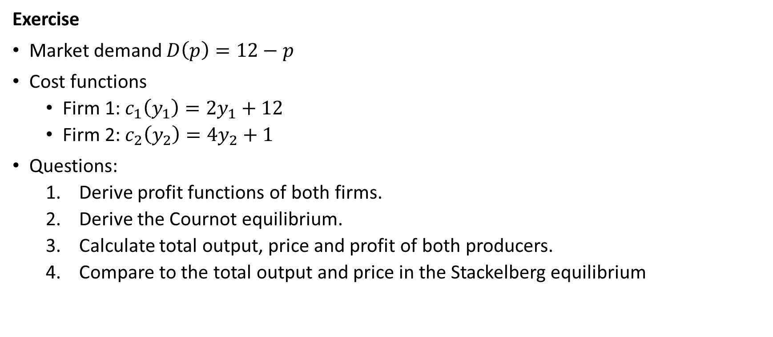
Simultaneous quantity setting (Cournot)
Exercise
Market demand $D\left(p\right)=12−p$
Cost functions
Firm 1: $c_{1}\left(y_{1}\right)=2y_{1}+12$
Firm 2: $c_{2}\left(y_{2}\right)=4y_{2}+1$
Questions:
Derive profit functions of both firms.
Derive the Cournot equilibrium.
Calculate total output, price and profit of both producers.
Compare to the total output and price in the Stackelberg equilibrium

Slide 24


Simultaneous price setting (Bertrand)
2 (or more) firms deciding price simultaneously
Examples
A B

Slide 25
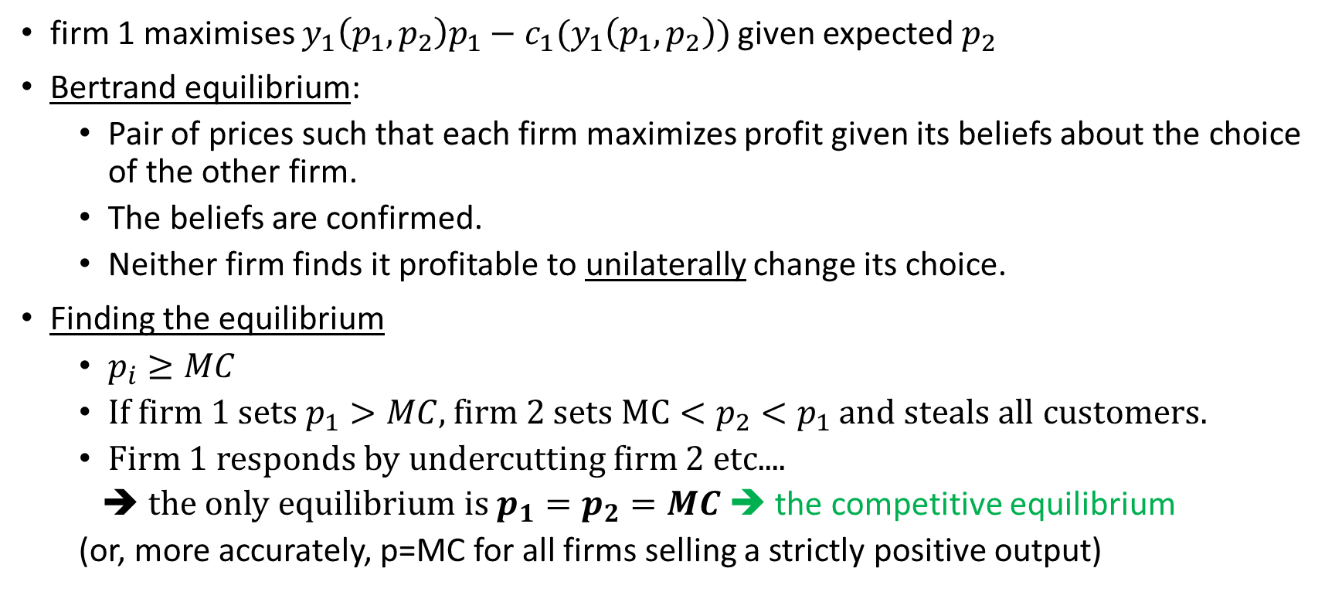
Simultaneous price setting (Bertrand)
firm 1 maximises $y_{1}\left(p_{1},p_{2}\right)p_{1}−c_{1}(y_{1}\left(p_{1},p_{2}\right))$ given expected $p_{2}$
Bertrand equilibrium:
Pair of prices such that each firm maximizes profit given its beliefs about the choice of the other firm.
The beliefs are confirmed.
Neither firm finds it profitable to unilaterally change its choice.
Finding the equilibrium
$p_{i}≥MC$
If firm 1 sets $p_{1}>MC$, firm 2 sets $MC<p_{2}<p_{1}$ and steals all customers.
Firm 1 responds by undercutting firm 2 etc....
➔ the only equilibrium is $p_{1}=p_{2}=MC$ ➔ the competitive equilibrium
(or, more accurately, p=MC for all firms selling a strictly positive output)
What is the Bertrand equilibrium?

Slide 26
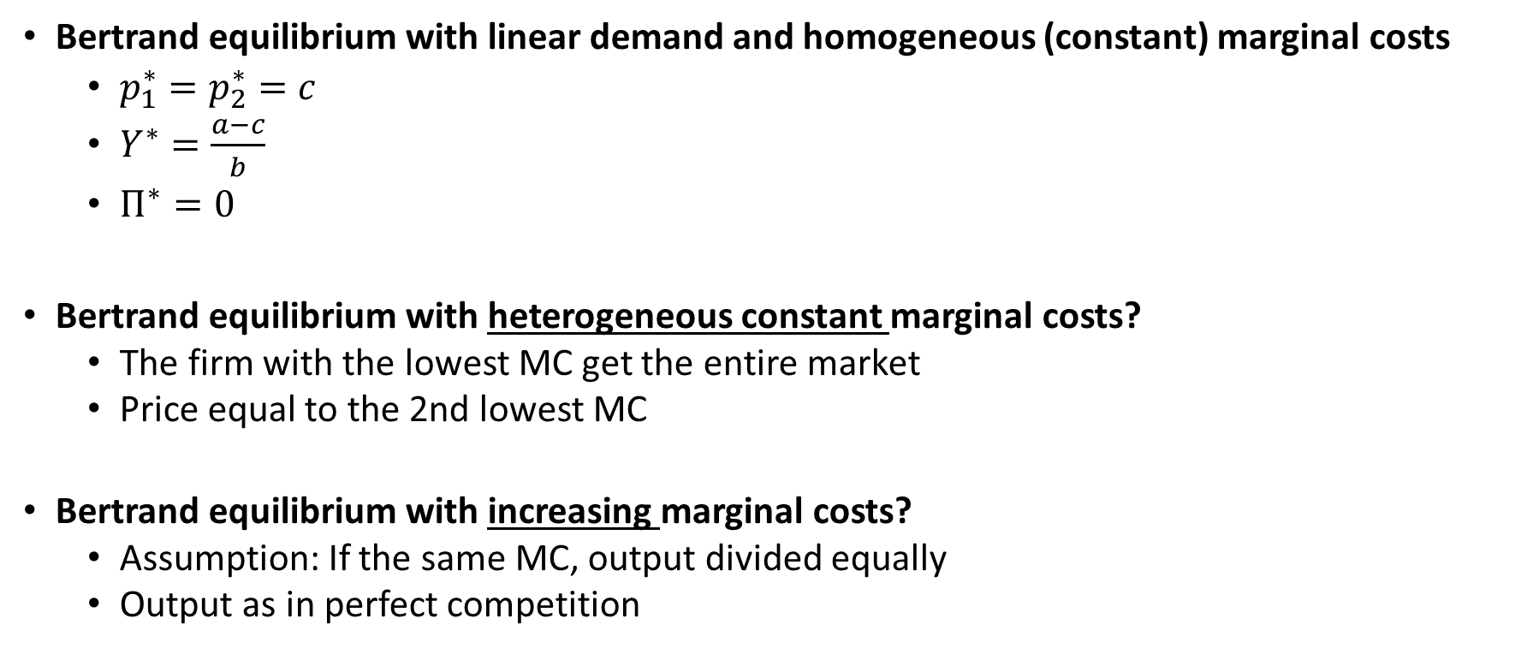
Simultaneous price setting (Bertrand)
Bertrand equilibrium with linear demand and homogeneous (constant) marginal costs
$p_{1}^{∗}=p_{2}^{∗}=c$
$Y^{∗}=\frac{a−c}{b}$
$Π^{∗}=0$
Bertrand equilibrium with heterogeneous constant marginal costs?
The firm with the lowest MC get the entire market
Price equal to the 2nd lowest MC
Bertrand equilibrium with increasing marginal costs?
Assumption: If the same MC, output divided equally
Output as in perfect competition

Slide 27
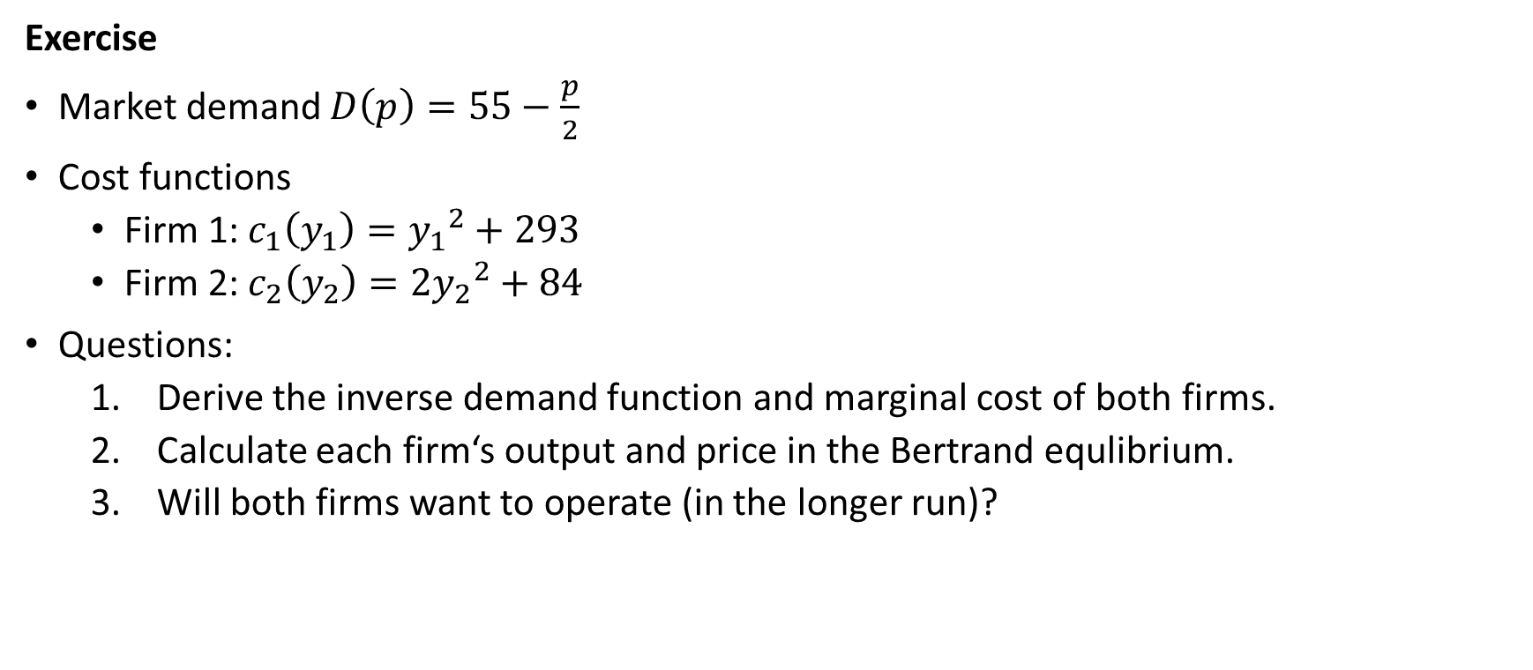
Simultaneous price setting (Bertrand)
Exercise
Market demand $D\left(p\right)=55−\frac{p}{2}$
Cost functions
Firm 1: $c_{1}\left(y_{1}\right)={y_{1}}^{2}+293$
Firm 2: $c_{2}\left(y_{2}\right)=2{y_{2}}^{2}+84$
Questions:
Derive the inverse demand function and marginal cost of both firms.
Calculate each firm‘s output and price in the Bertrand equlibrium.
Will both firms want to operate (in the longer run)?

Slide 28

Co-operative setting (collusion)
Collusion = non-competitive agreement between competitors
Cartel = a group of colluding firms
Examples
A B

Slide 29
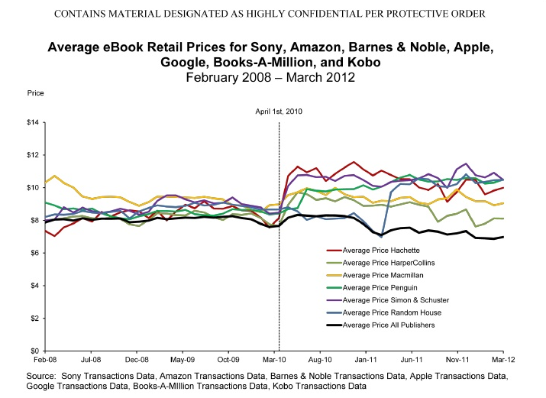
E-book price fixing
Background:
E-book market help by Amazon
Publishes threathened by cheap e-books
Apple releasing the iPad
Secret meetings by „Big 6“ CEOs
Publishers approached by Apple
The deal:
In action 10th April 2010
Sell e-books via iBookstore under an agency model (30% commission for Apple)
Price tiers set up by Apple
Increase prices of most books to 9.99-14.99
Amazon also had to switch to the agency model (publishers co-ordinated in negotiations with Amazon)
Ruling:
The „Big 6“ US publishers + Apple conspired to raise the prices of e-books
Apple to pay a fine of USD 450 millions

Slide 30
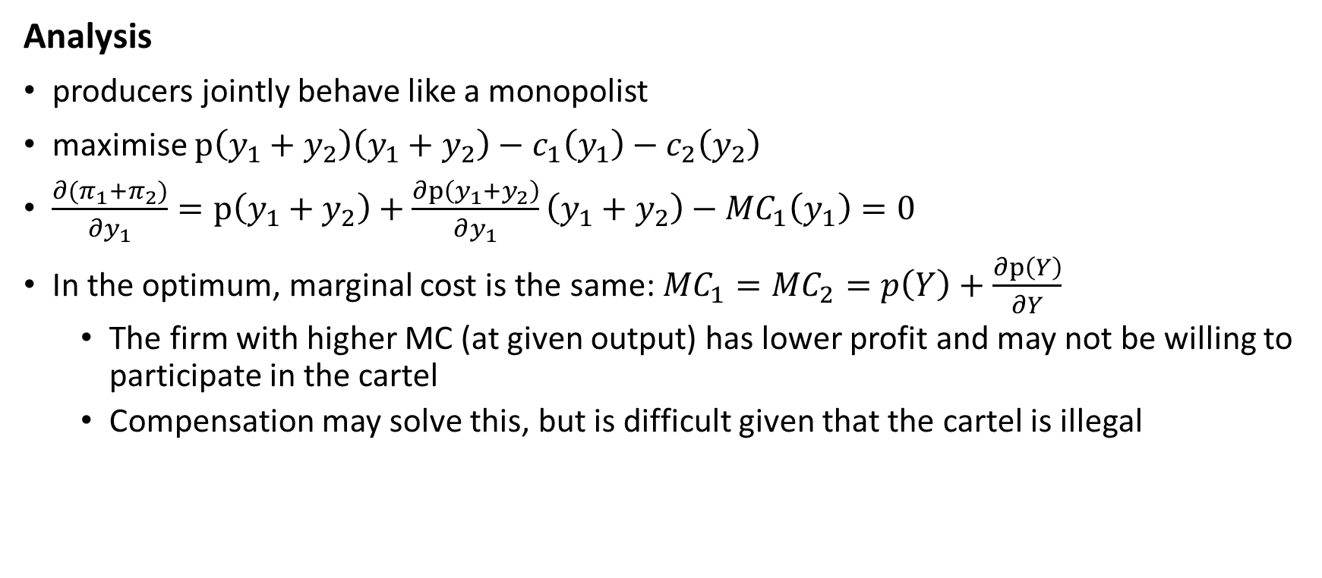
Co-operative setting (collusion)
Analysis
producers jointly behave like a monopolist
maximise $p\left(y_{1}+y_{2}\right)\left(y_{1}+y_{2}\right)−c_{1}\left(y_{1}\right)−c_{2}\left(y_{2}\right)$
$\frac{∂(π_{1}+π_{2})}{∂y_{1}}=\text{p}\left(y_{1}+y_{2}\right)+\frac{∂p\left(y_{1}+y_{2}\right)}{∂y_{1}}\left(y_{1}+y_{2}\right)−{MC}_{1}\left(y_{1}\right)=0$
In the optimum, marginal cost is the same: ${MC}_{1}={MC}_{2}=p\left(Y\right)+\frac{∂p\left(Y\right)}{∂Y}$
The firm with higher MC (at given output) has lower profit and may not be willing to participate in the cartel
Compensation may solve this, but is difficult given that the cartel is illegal

Slide 31
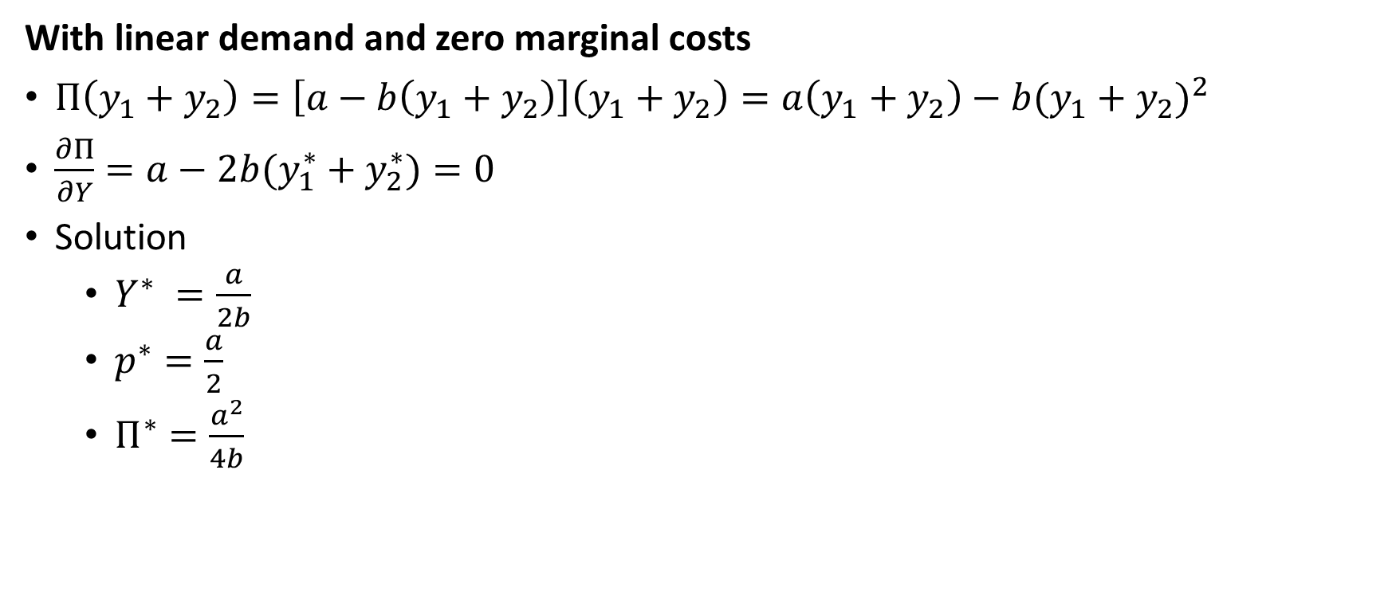
Co-operative setting (collusion)
With linear demand and zero marginal costs
$Π\left(y_{1}+y_{2}\right)=\left[a−b\left(y_{1}+y_{2}\right)\right]\left(y_{1}+y_{2}\right)=a\left(y_{1}+y_{2}\right)−b{(y_{1}+y_{2})}^{2}$
$\frac{∂Π}{∂Y}=a−2b(y_{1}^{∗}+y_{2}^{∗})=0$
Solution
$Y^{∗} =\frac{a}{2b}$
$p^{∗}=\frac{a}{2}$
$Π^{∗}=\frac{a^{2}}{4b}$

Slide 32
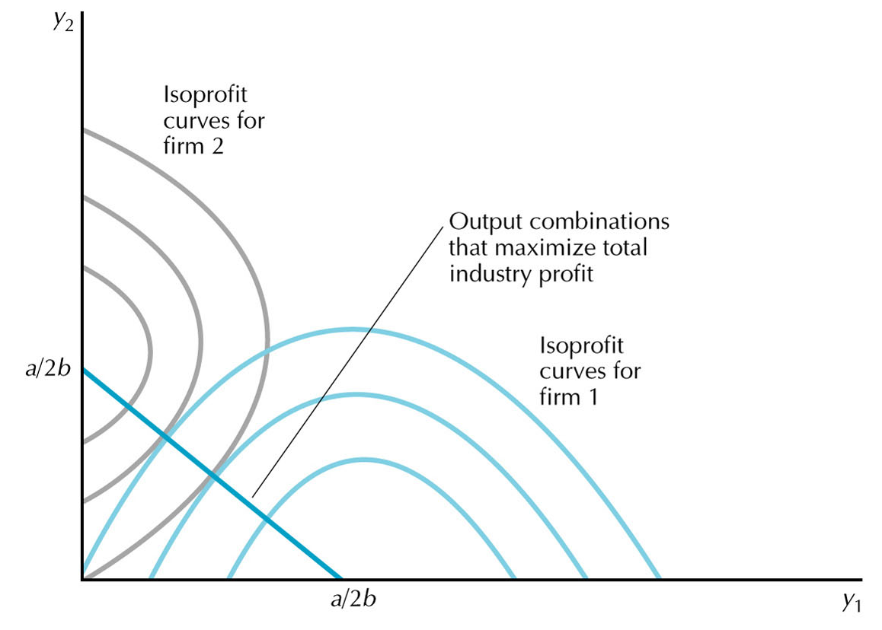
Co-operative setting (collusion)

Slide 33
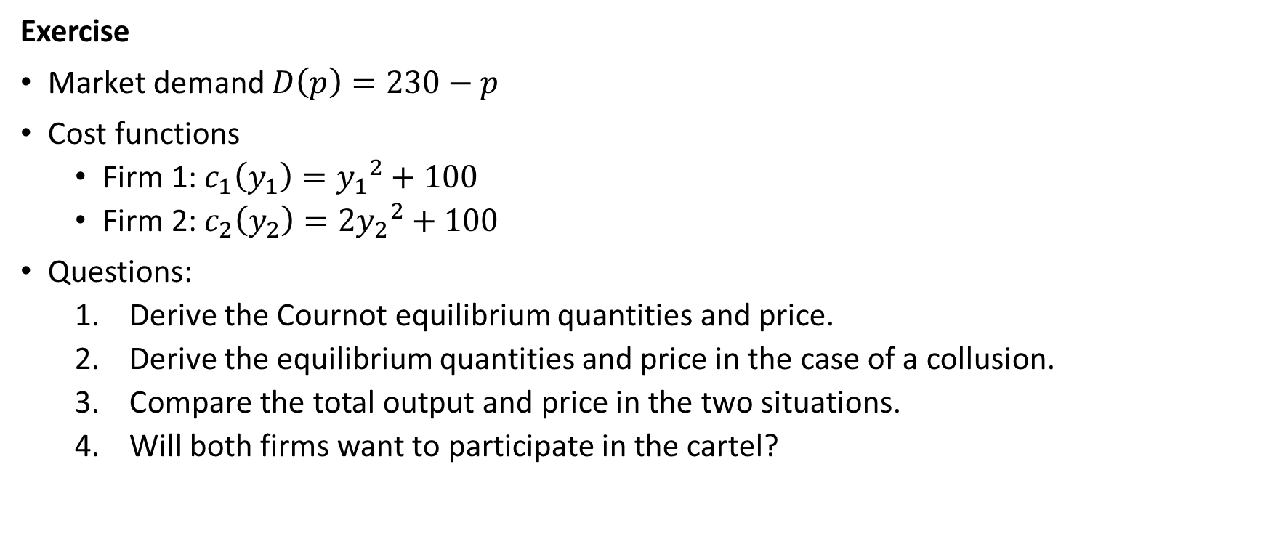
Co-operative setting (collusion)
Exercise
Market demand $D\left(p\right)=230−p$
Cost functions
Firm 1: $c_{1}\left(y_{1}\right)={y_{1}}^{2}+100$
Firm 2: $c_{2}\left(y_{2}\right)=2{y_{2}}^{2}+100$
Questions:
Derive the Cournot equilibrium quantities and price.
Derive the equilibrium quantities and price in the case of a collusion.
Compare the total output and price in the two situations.
Will both firms want to participate in the cartel?

Slide 34
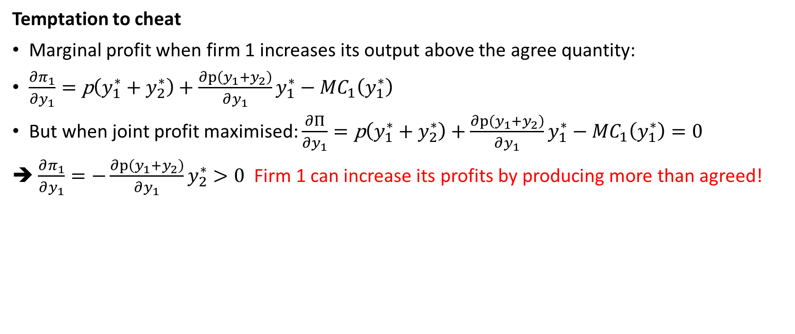
Co-operative setting (collusion)
Temptation to cheat
Marginal profit when firm 1 increases its output above the agree quantity:
$\frac{∂π_{1}}{∂y_{1}}=\text{p}\left(y_{1}^{∗}+y_{2}^{∗}\right)+\frac{∂p\left(y_{1}+y_{2}\right)}{∂y_{1}}y_{1}^{∗}−{MC}_{1}\left(y_{1}^{∗}\right)$
But when joint profit maximised: $\frac{∂Π}{∂y_{1}}=\text{p}\left(y_{1}^{∗}+y_{2}^{∗}\right)+\frac{∂p\left(y_{1}+y_{2}\right)}{∂y_{1}}y_{1}^{∗}−{MC}_{1}\left(y_{1}^{∗}\right)=0$
➔ $\frac{∂π_{1}}{∂y_{1}}=−\frac{∂p\left(y_{1}+y_{2}\right)}{∂y_{1}}y_{2}^{∗}>0$ Firm 1 can increase its profits by producing more than agreed!

Slide 35
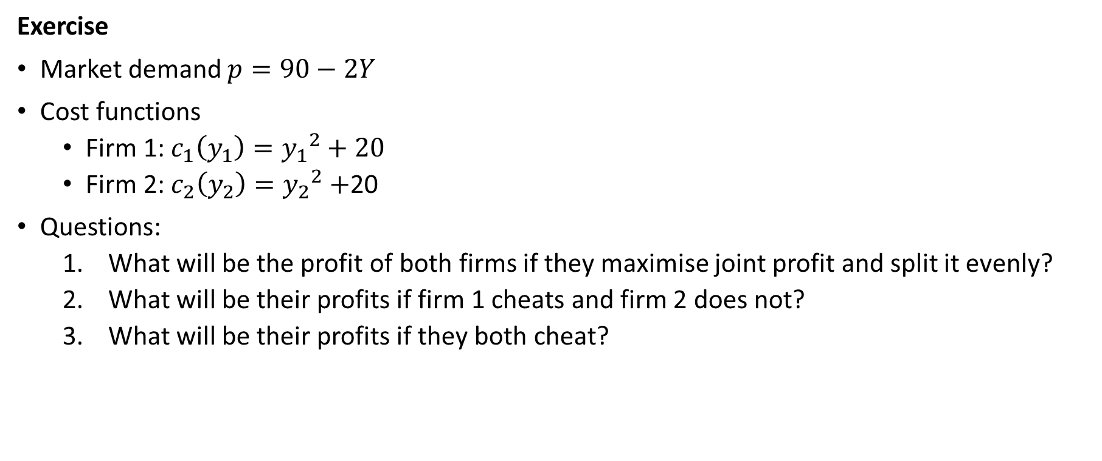
Co-operative setting (collusion)
Exercise
Market demand $p=90−2Y$
Cost functions
Firm 1: $c_{1}\left(y_{1}\right)={y_{1}}^{2}+20$
Firm 2: $c_{2}\left(y_{2}\right)={y_{2}}^{2}+$20
Questions:
What will be the profit of both firms if they maximise joint profit and split it evenly?
What will be their profits if firm 1 cheats and firm 2 does not?
What will be their profits if they both cheat?

Slide 36
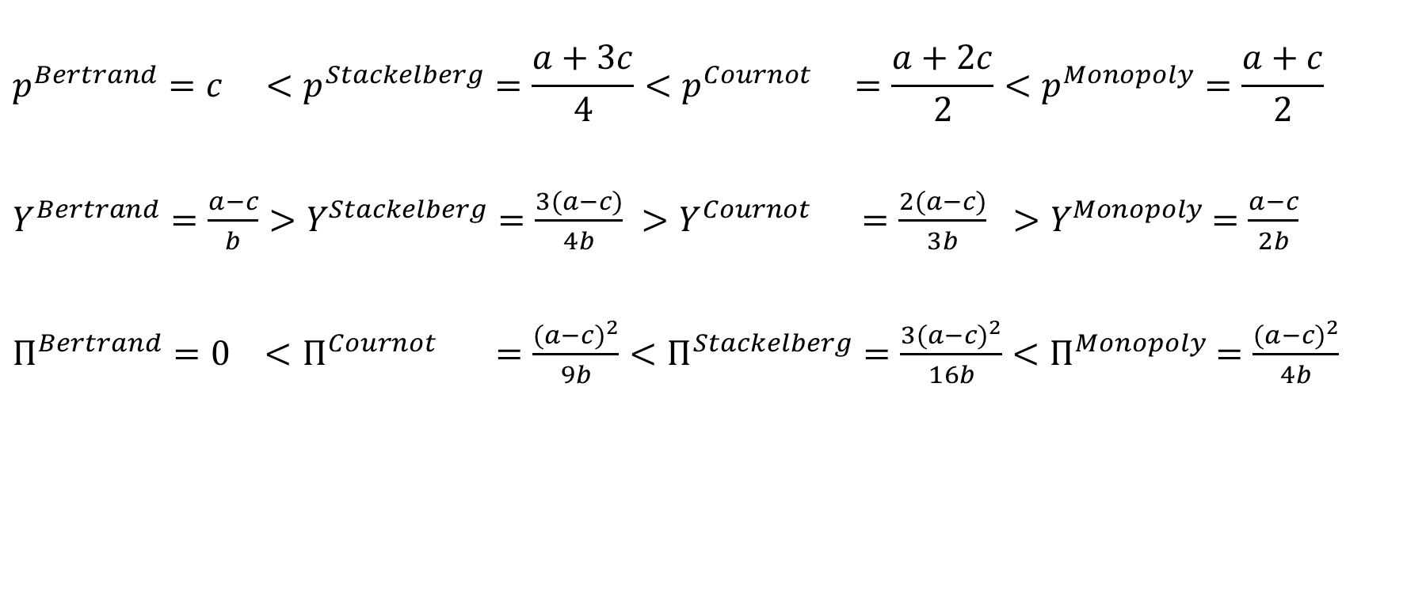
Comparison of oligopoly settings (with homogenous products)
$$p^{Bertrand}=c <p^{Stackelberg}=\frac{a+3c}{4}<p^{Cournot} =\frac{a+2c}{2}<p^{Monopoly}=\frac{a+c}{2}$$
$Y^{Bertrand}=\frac{a−c}{b}>Y^{Stackelberg}=\frac{3(a−c)}{4b} >Y^{Cournot} =\frac{2(a−c)}{3b} >Y^{Monopoly}$ $=\frac{a−c}{2b}$
$Π^{Bertrand}=0 <Π^{Cournot} =\frac{{(a−c)}^{2}}{9b}<Π^{Stackelberg}=\frac{3{(a−c)}^{2}}{16b}<Π^{Monopoly}$ $=\frac{{(a−c)}^{2}}{4b}$
Note that Stackelberg implies lower price and greater total output than Cournot, but also greater total profits

Slide 37

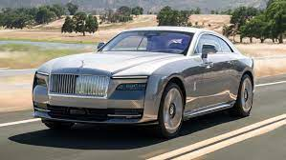
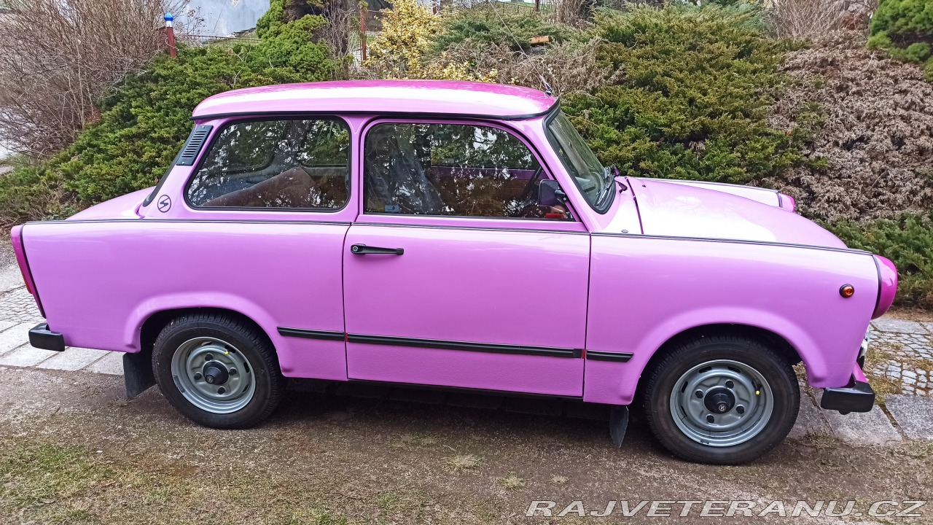
Differentiated (heterogeneous) products
In many real-world markets they differentiate their products (substitutes), in terms of quality, style, branding, guaranties, advertising, etc.
Horizontal differentiation:
Vertical differentiation: VS.
As a result they can keep part of a market even if they charge different prices.
We discuss 3 settings with (horizontal) product differentiation
Price setting with heterogeneous products (Bertrand)
Spatial model of horizontal differentiation
Monopolistic competition

Slide 38
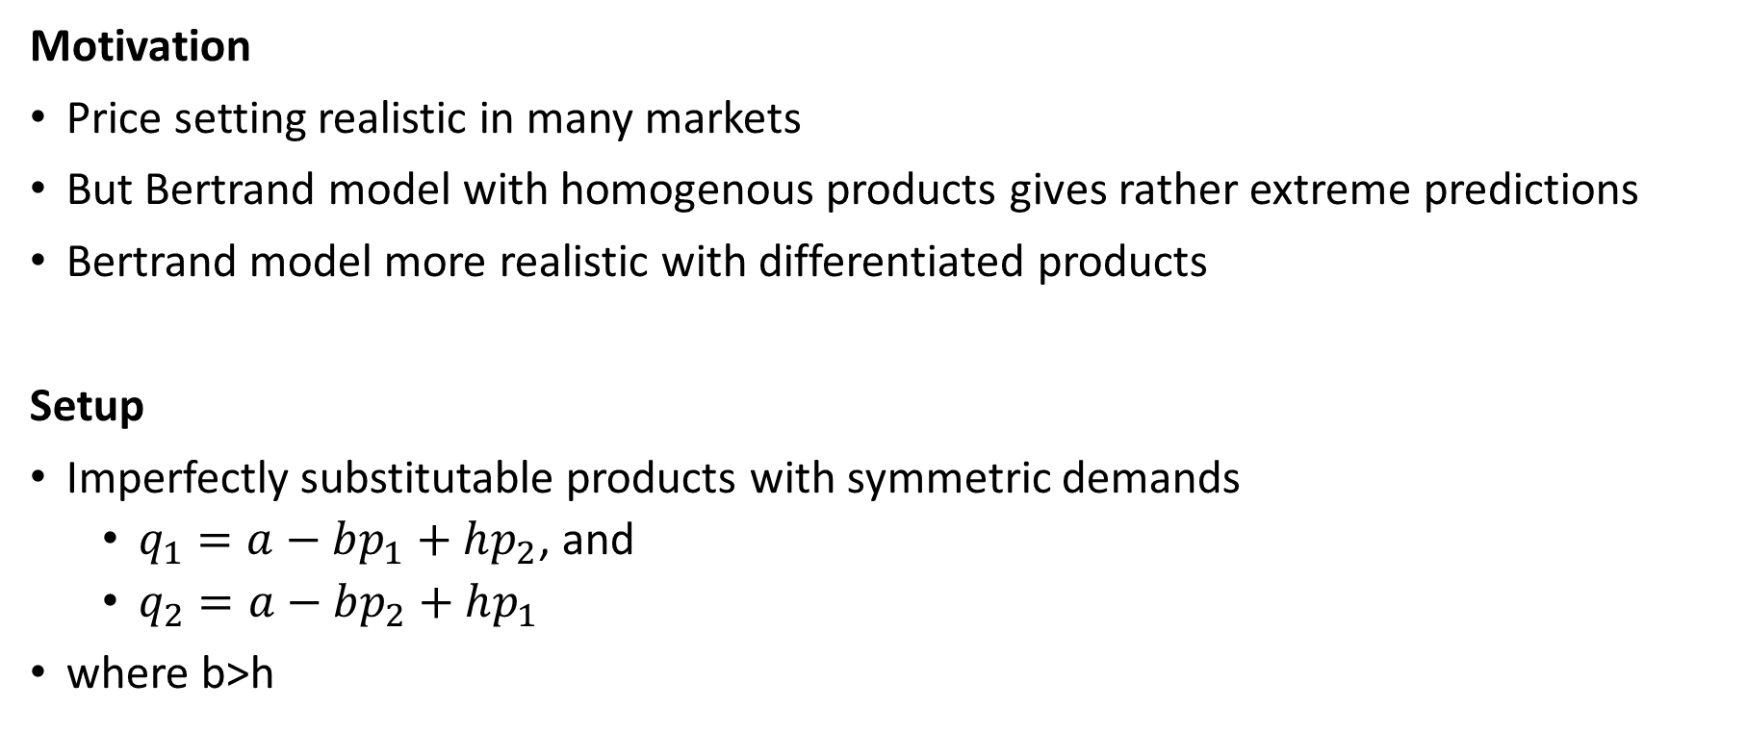
Price setting with differ. products (Bertrand)
Motivation
Price setting realistic in many markets
But Bertrand model with homogenous products gives rather extreme predictions
Bertrand model more realistic with differentiated products
Setup
Imperfectly substitutable products with symmetric demands
$q_{1}=a−bp_{1}+hp_{2}$, and
$q_{2}=a−bp_{2}+hp_{1}$
where b>h

Slide 39
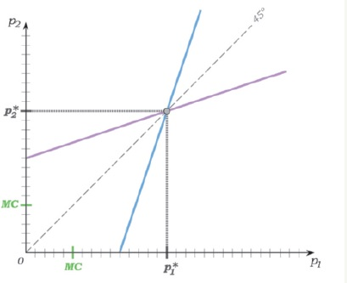
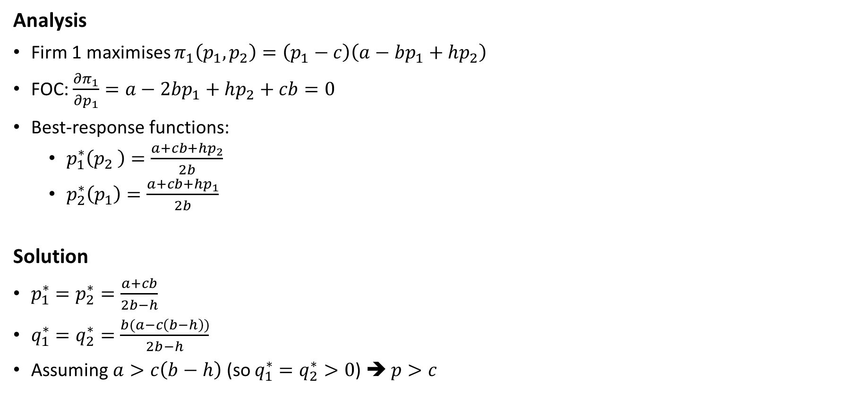
Price setting with differ. products (Bertrand)
Analysis
Firm 1 maximises $π_{1}\left(p_{1},p_{2}\right)=\left(p_{1}−c\right)\left(a−bp_{1}+hp_{2}\right)$
FOC: $\frac{∂π_{1}}{∂p_{1}}=a−2bp_{1}+hp_{2}+cb=0$
Best-response functions:
$p_{1}^{∗}\left(p_{2} \right)=\frac{a+cb+hp_{2}}{2b}$
$p_{2}^{∗}\left(p_{1}\right)=\frac{a+cb+hp_{1}}{2b}$
Solution
$p_{1}^{∗}=p_{2}^{∗}=\frac{a+cb}{2b−h}$
$q_{1}^{∗}=q_{2}^{∗}=\frac{b(a−c\left(b−h\right))}{2b−h}$
Assuming $a>c\left(b−h\right)$ (so $q_{1}^{∗}=q_{2}^{∗}>0$) ➔ $p>c$

Slide 40
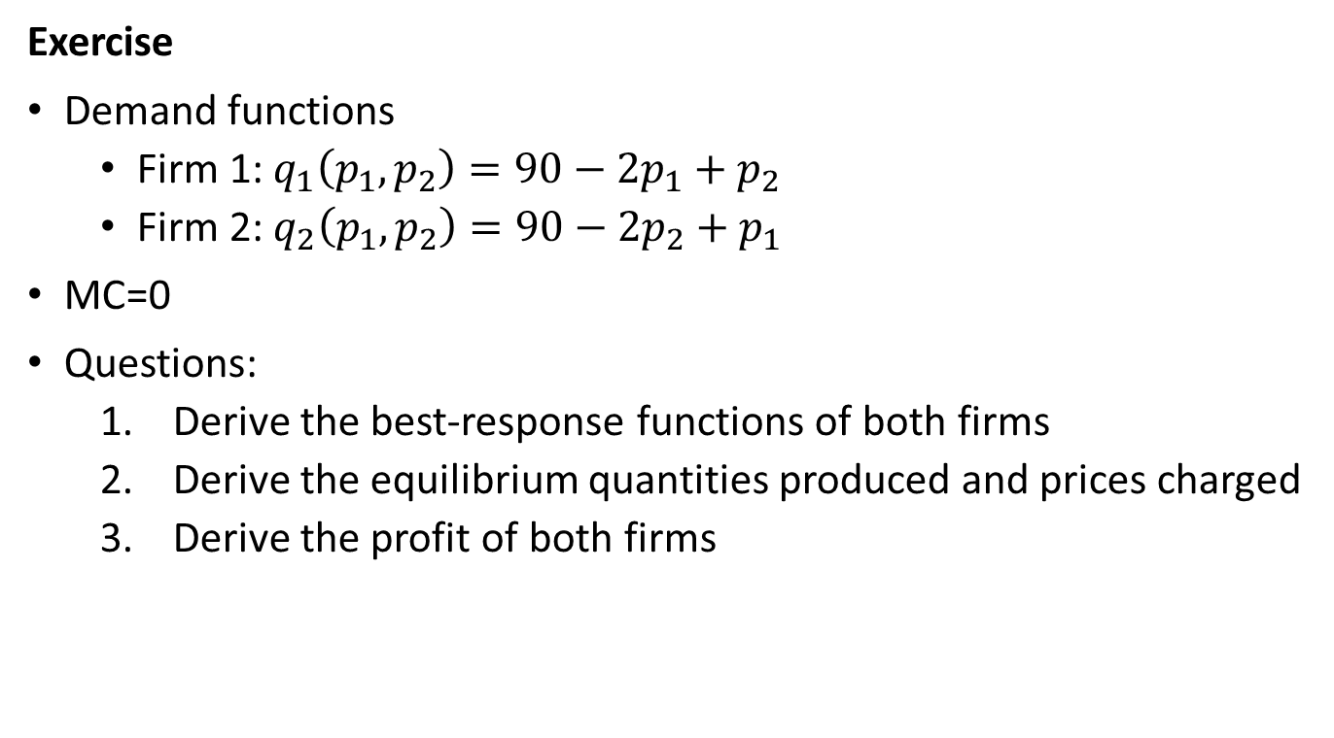
Price setting with differ. products (Bertrand)
Exercise
Demand functions
Firm 1: $q_{1}\left(p_{1},p_{2}\right)=90−2p_{1}+p_{2}$
Firm 2: $q_{2}\left(p_{1},p_{2}\right)=90−2p_{2}+p_{1}$
MC=0
Questions:
Derive the best-response functions of both firms
Derive the equilibrium quantities produced and prices charged
Derive the profit of both firms

Slide 41
Spatial model of horiz. differentiation (Hotelling)
Setup
Product differentiation endogeneously determined by firms
Differentiation modeled as product location
Consumers also characterised by the location of each consumer
Consume one unit of the good
Incur transportation costs which depend on the distance to firm
Literal interpretation (physical location) or metaphorical interpretation (location in the product space)
Two-stage game:
Firms choose location
Firms choose price where location is chosen first and price afterwards.
Intuition: firms choose maximum product differentiation to minimise price competition in 2nd starge

Slide 42
Spatial model of horiz. differentiation (Hotelling)
1 firm
Locates in middle of consumer preferences
Socially optimal
0
1

Slide 43
Spatial model of horiz. differentiation (Hotelling)
2 firms
Have incentive to move towards the other firm (they gain extra consumer but do not lose any)
In equilibrium, both firms in the middle
Inefficient, as a socially optimal location would be in 1/4 and 3/4 of the line
0
1

Slide 44
Spatial model of horiz. differentiation (Hotelling)
3 firms
The outside firms have an incentive to get towards the middle one
But once they get very close, the middle one has an incentive to skip towards the edge
No (pure strategy) equilibrium
> 3 firms
(Pure strategy) equilibria exist
0
1

Slide 45

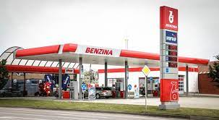

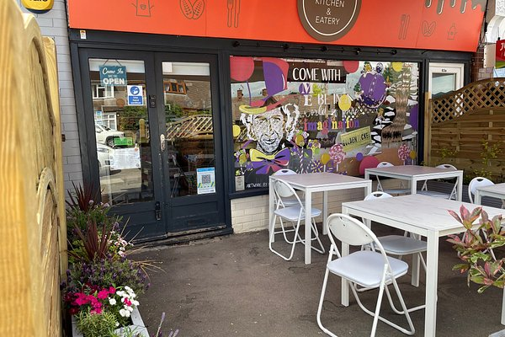
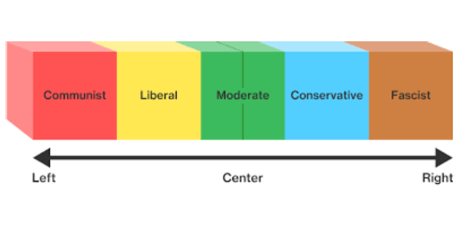
Spatial model of horiz. differentiation (Hotelling)
Examples
Ice-cream vendors on a beach
Petrol stations along a highway
Posh vs. cheap restaurants
Political parties

Slide 46
Monopolistic competition
Setup
Products are substitutes but differ (e.g. by features, brand etc.)
Elements of both competition and monopoly
Like a monopoly
Each firm faces a downward sloping demand curve
The stronger the product differentiation, the less elastic the demand curve
Like perfect competition
The demand curve depends on output and price decisions of other firms
Each firm too small to consider its effects on other firms
Free entry
Demand curve shifts inwards as more firms enter
Demand curve becomes more elastic, as there are more firms selling products with similar features

Slide 47
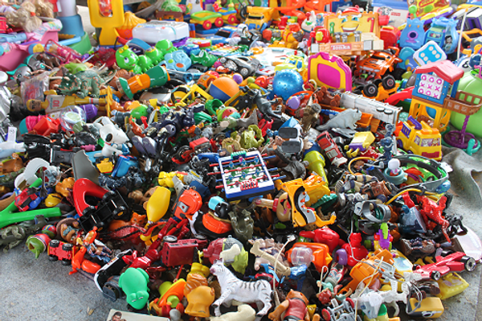
Monopolistic competition
Examples
Most manufacturing industries
E.g. toys, tableware etc. etc.
Many services:
E.g. accountants, therapists...

Slide 48
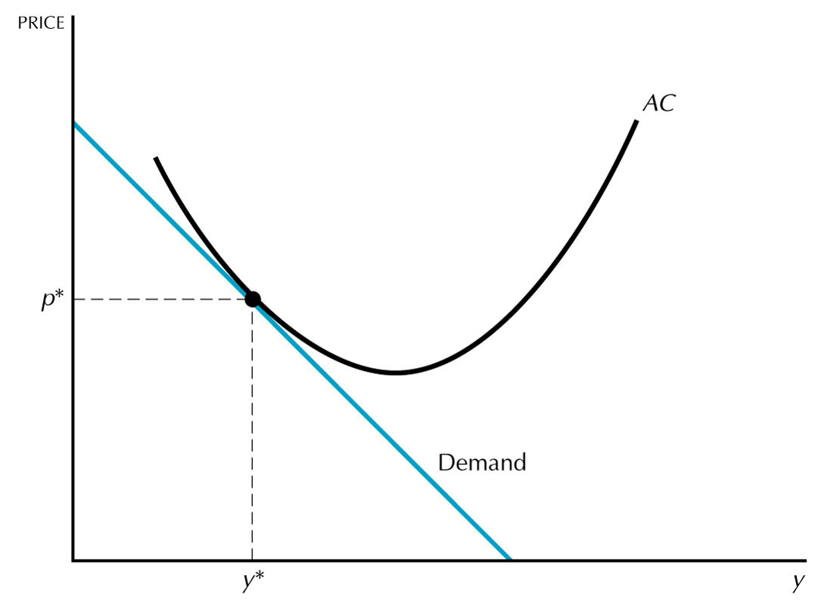
Monopolistic competition
Analysis
Equilibrium conditions
Each firm selling at price and output combination on its demand curve
Firms maximize profit.
Free entry pushes profit to zero.
D and AC curves are tangent.
Pareto inefficient situation as p > MC
Firms operate to the left of the AC minimum
„Excess capacity“
Fewer firms would mean more efficient scale, but lower variety.

